Slide 1


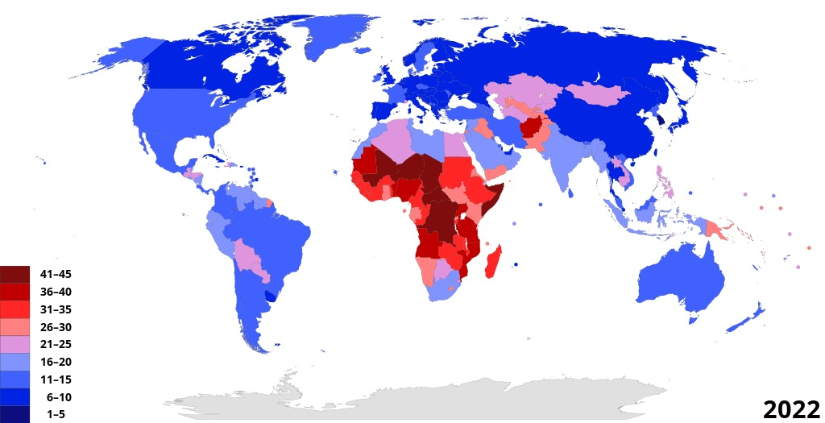
AI for Healthcare: Smart Solutions for Newborn Well-being
One universal challenge for young parents worldwide is understanding their baby's cries.
Misinterpreting cries can lead to stress for parents and delayed care for babies, impacting long-term health and bonding.
With 130+ millions babies born annually, the need for an tools for help babies and young parents is urgent.
Notes:
\

Slide 2

Letting Baby Talk To You
Smart, Fast, Accessible
Seamless on iOS & Android
Install in 5 seconds
Get results in 3 seconds
Achieve over 90% accuracy
Able to learn novel reason from more data

